Slide 1
Update Team: Eugin and Seng Tian
27th March 2020

Slide 2
Things we have done this week
Refine our code to make things smooth, we work on each others feedback and inputs
Research on evaluation methods, BLEU and ROUGE
Research on fine tuning the BERT model but found it challenging, most online resources don’t discuss much. “mostly plug and play”
Calculating ROUGE score and evaluations

Slide 3
Things we will do next week (last week)
Wrapping up ☺
Documentations. Report writing
Cleaning up the code

Slide 4
Why we ROUGE instead of BLEU
Aim: to compare against BERT generated summary against user summary
Generally they work the same using n-grams, and a variation of recall and precision
ROUGE provide us the recall, precision and the F-score which give us insight on whether the BERT summary is too vague or too rich.
F-score give a good aggregation of the results
BLEU doesn’t seem to work very well when there are differences in the summary corpus length, brevity penalty

Slide 5
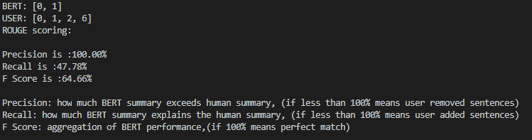
ROUGE example
In this example,
BERT model highlighted : sentences 0, 1
USER highlighted: 0, 1, 2, 6
We are able to gauge the correctness of the model which is 65% (relative comparison)
We know that the error is because of recall: 1) thus, we can increase pre-training corpus for this project 2) we can tweak the parameters to increase length of summary output
BLEU: we only get one number.

Slide 6
Streamlit “WebApp” Update

